Slide 1
Civil society under threat: How can HIV advocates resist the impact? Experience from Russia
Ivan Varentsov
25.07.2018.
Amsterdam. AIDS 2018.

Slide 2
Andrey Rylkov Foundation
Grass-roots organization from Moscow (Russia) established in 2009
Mission: to promote and develop humane drug policy based on tolerance, protection of health, dignity and human rights
Key activities:
Harm reduction service provision
Drug policy related advocacy (with focus on access to OST)
Drug policy and human rights focused watchdogging
Capacity building of PWUD community

Slide 4
HIV in Russia
EECA is the only region in the world with growing HIV epidemic
Russia accounted for 81% of new HIV cases in the region in 2016 - „driving force“ of the epidemic in the region (UNAIDS)
Concentrated epidemic among KAPs (PWIDs, SWs, MSM)
About 70% of all HIV cases in Russia are associated with the use of injecting drugs
More then 1 220 000 cases being registered as on the end of 2017
Coverage of PLH by HIV treatment is about 35%

Slide 5
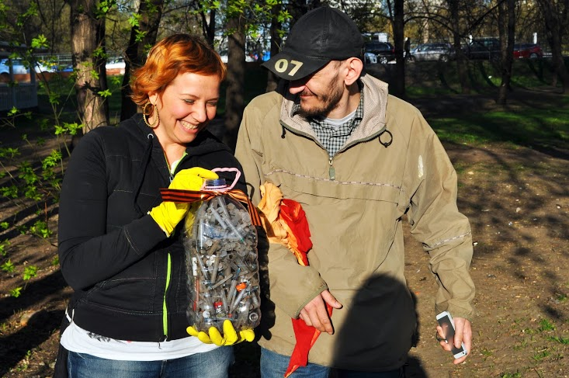

Slide 6
“Foreign agents” law
July 2012 – new version of a law regulating NGOs’ activities: all NGOs receiving foreign funding and\or trying to influence Russian policy should be registered as “foreign agents”
Mandatory audit inspections every year; quarterly reports on the activities to MoJ; need to label all printed and electronic materials with a stamp of foreign agent; fines for violation of the provisions of the law.
More then 1000 NGOs undergone unexpected inspections by prosecution offices in 2013
In June 2014 Ministry of Justice got the right to decide themselves which NGO is a “foreign agent”. A month later the same Ministry issued an order to start unscheduled audit and inspections of all AIDS service NGOs in country
Since 2016 10 NGOs providing HIV prevention services were included into the list - the last one (Timur Islamov Foundation) was included two weeks ago.

Slide 8
Our situation and fight back
ARF was labeled as foreign agent in June 2016. Our “political activity” - advocacy for introduction of opioid substitution treatment in Russia.
In August 2016 we went to the court against the Ministry of Justice and after two consecutive trials the court has dismissed the case of an administrative offense for the absence of the administrative offense, no fine was charged as well.
But in 2017 we lost few trials against MoJ trying to revoke the status of a foreign agent
Now we are heading for the European Court on Human Rights with this case.

Slide 9
Conclusions
We do carry out our work using foreign funding but it is not our choice – we tried to apply for the governmental funding several times but never received any support
New Russian HIV strategy till 2020 does not support harm reduction services – no governmental funding is expected till then
Our work have not been affected by the “foreign agent” status yet - but we are constantly under a threat of being fined for any minor violation of the “foreign agent” law which actually could lead to the closure of the organization.
This law is an instrument to control independent NGOs which could be applied at any moment by the goverment if needed

